Slide 1

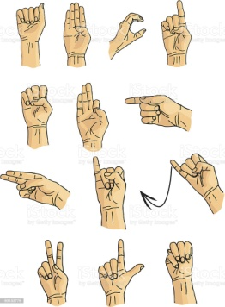
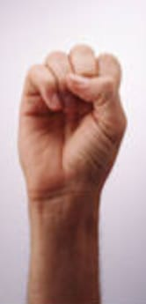
SIGN LANGUAGE RECOGNITION
HOLY MARY INSTITUTE OF TECHNOLOGY & SCIENCE
(Approved by AICTE, New Delhi, Affiliated to JNTU, Hyderabad)
BOGARAM(V),KEESARA(M),MEDCHAL DISTRICT-501301
2021-2022
DEPARTMENT OF COMPUTER SCIENCE ENGINEERING
By:
Katla Varshitha - 18C91A0546
Gundu Vamshi Krishna - 18C91A0529
K.Karthik Reddy - 18C91A0535
Under the Guidance of:
Mrs.SreeLakshmi

Slide 2
ABSTRACT
This project aims to develop a sign detector, which detects hand gestures of sign language, which is used by deaf and dumb people to exchange information between their own community and with other people. Knowing sign language is not something that is common to all, this project can be very helpful for the deaf and dumb people in communicating with others ,this can also be extended to automatic editors. Three dimensional spaces and the hand movements are used to identify meanings. The goal of this project is to identify and review the sign language recognition with an efficient output.

Slide 3
EXISTING SYSTEM
There are few similar applications, which are mainly used to translate text to sign language ,
Wecapable.com: This tool easily converts English text into sign language symbols. It is useful for both teaching and learning American sign language.
Hand Talk: Hand Talk app is a pocket translator that automatically translates oral languages both in text and audio to sign languages, such as English to ASL .

Slide 4
DISADVANTAGES OF EXISTING SYSTEM
The applications existing lack the option of translating a sign language gesture to a text.
These applications cannot be used by deaf and dumb community to interact with people who are not familiar with sign language.
The existing applications are costly and difficult to be used commercially.

Slide 5
PROPOSED SYSTEM
The project aims at building an ML - based application which can translate hand gestures to text.
It is a camera based sign language recognition system that would be useful for the deaf and dumb for converting sign language gestures to text.
The data acquisition, data preprocessing and transformation, feature extraction, classification and results obtained are examined.
We use small dataset for pre-training.
The project flow goes by collecting images using OpenCV ,Python and labelling them using label image package and then building a sign language detector to detect the sign language in real time.

Slide 6
ADVANTAGES OF PROPOSED SYSTEM
It works on any background(uses image processing)
The system provides natural interaction to its users.
The application can be used 24/7 as it does not require any internet connection.
It works better tool for communication for deaf and dumb people.

Slide 7



SYSTEM REQUIREMENTS
Software Requirements:
Python
OpenCV
Keras
TensorFlow
NumPy
Hardware Requirements:
4 GB Ram
1 GB Free Space
Web Cam (5 MP preferable)

Slide 8
SYSTEM DESIGN
Web Camera
Sign Language Detection
Using hand Gestures
Data Pre Processing
Scan Gestures
Export To File
Export To The File
Show Generated Labels
Generated Output

Slide 9
SYSTEM ANALYSIS
Usability –
The system should provide natural interaction to its users. The hearing impaired person needs to worry nothing else, just for performing signs.
Availability -
The application can be used 24/7 as it does not require any internet connection.
Accuracy –
Signs should not be confused and the system should recognize appropriate sign.

Slide 10
IMPLEMENTATION
1.Dataset creation :
We have created our own dataset by taking live feed from the video cam to detect the hand. These gestures will be saved in a directory. There will be two folders in this directory namely test and train ,each containing 10 folders containing captured images.
2.Training a CNN on the captured dataset :
Now on the created data set we train a CNN ,We fit the model and save it to be used in the last module ,the optimization algorithm used is SGD (stochastic gradient descent, that means the weights are updated at every training instance).After compiling the model we fit the model on train batches for 10 epochs

Slide 11
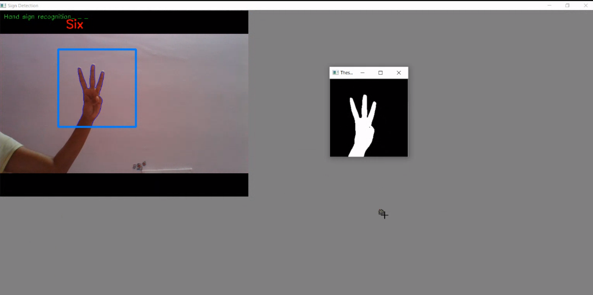
3.Prediction:
In this, we create a bounding box for ROI detection , as we did in creating the dataset.
This is done for identifying any foreground object .We load the previously saved model consisting of the hand as an input to the model for prediction.

Slide 12
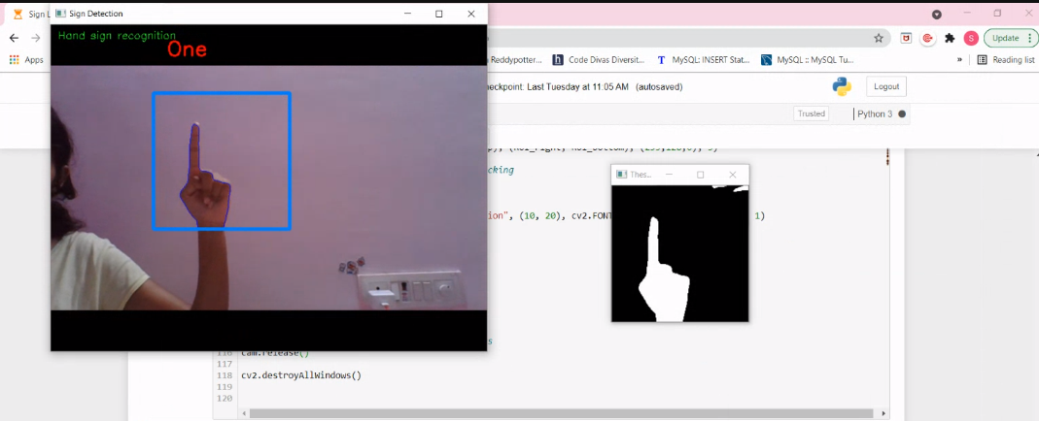
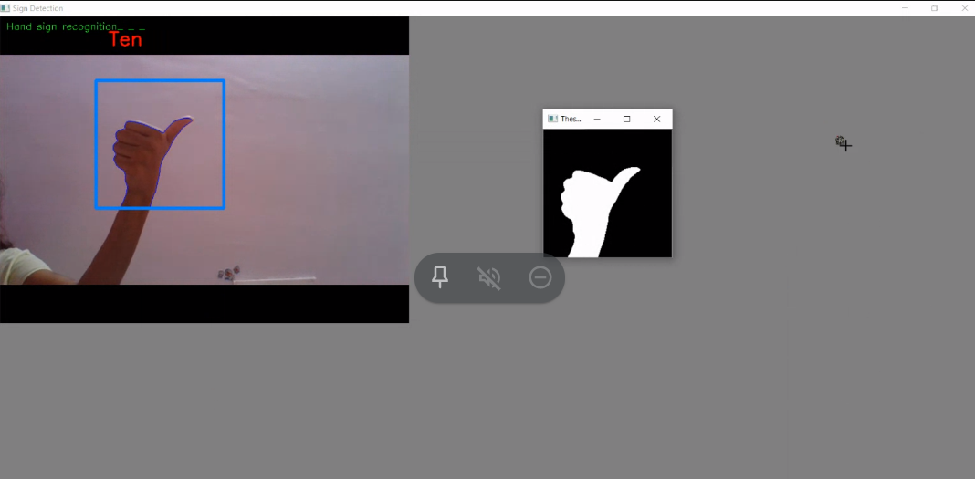
SYSTEM TESTING
Testcases:
1.Index finger is shown to webcam
2.Thumb with other fingers closed.

Slide 13
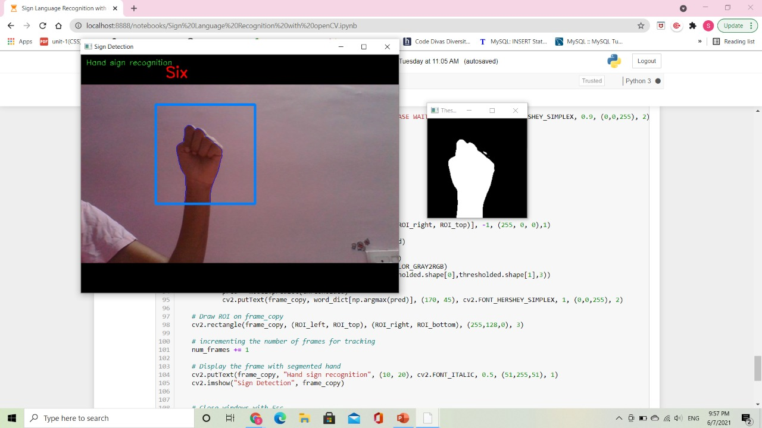
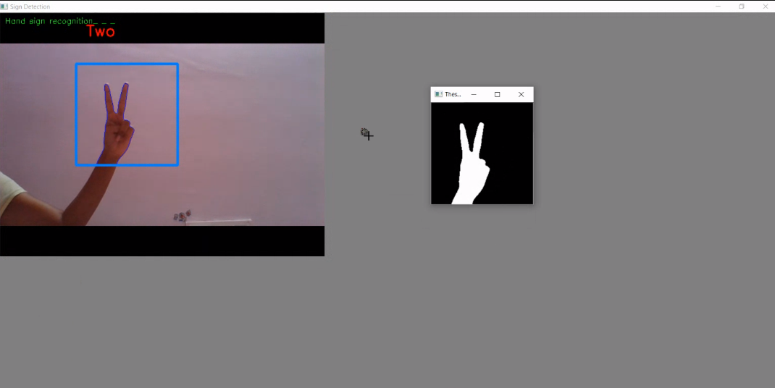
3.Gesture which is not in dataset.
4.IndexFinger,Middle finger is shown.

Slide 14
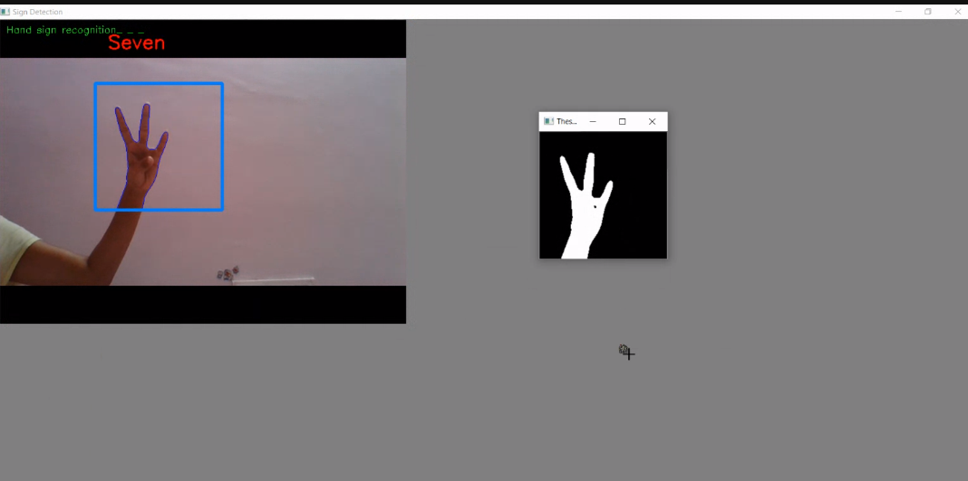
RESULTS
When the gesture for seven is shown to the webcam,output seven is displayed on screen.

Slide 15
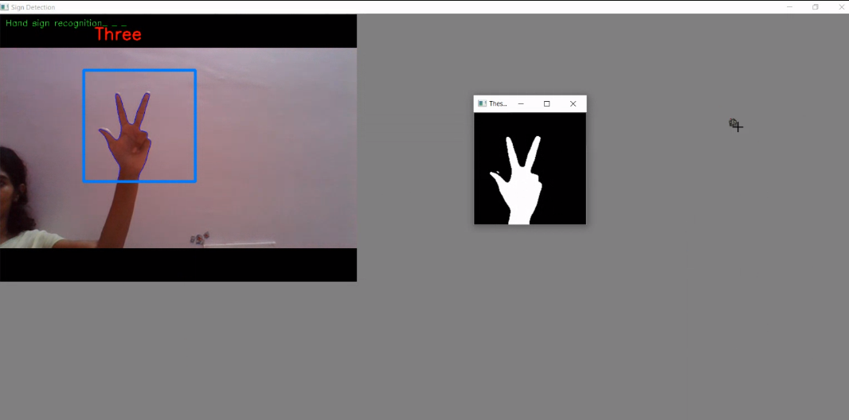
When the gesture for three is shown to the webcam,output three is displayed on screen.

Slide 16
FUTURE SCOPE
This can be further extended for detecting the English alphabets.
We can use ASL train and implement it ,so that could recognize ASL gestures.
User Interface need to be added for better user experience.
Accuracy can be improved.
Project can be extended with real time data.

Slide 17
CONCLUSION
Sign language recognition can help bridge the gap between people with hearing or speech impairment or who use sign language, and the rest of society who haven’t learned sign language. This leads to enhanced communication for all.
Sign language recognition is a hard problem if we consider all the possible combinations of gestures that a system of this kind needs to understand and translate. That being said, probably the best way to solve this problem is to divide it into simpler problems.
We use CNN to classify the sign gestures , which can successfully achieve a better accuracy.

Slide 18
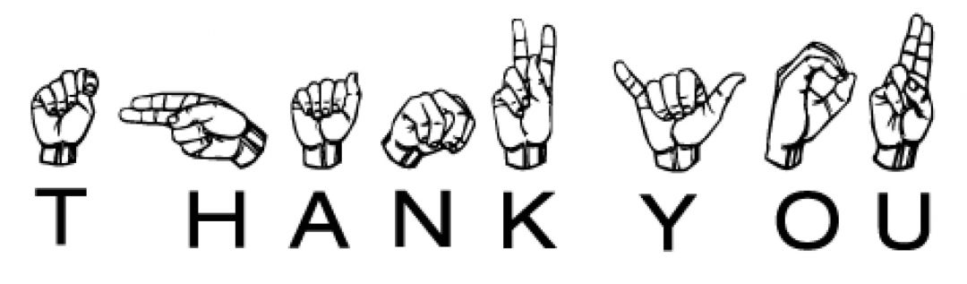
Thank You

